Slide 1
Efficient Optimisation of Qubit Control Pulses Using a Noise Operator Formalism and Genetic Algorithms
Chris Wise & Matt Woolley

Slide 2
Efficient Optimisation of Qubit Control Pulses Using a Noise Operator Formalism and Genetic Algorithms
Noise Operator Formalism and Machine Learning for Identification and Mitigation of Qubit-Environment Interactions
Chris Wise & Matt Woolley

Slide 3
Scope
Motivation
Noise Operator Formalism
Environment Identification
Deriving Noise Operator
Prediction of Noise Operator
Transformer-based Qubit Simulator
Qubit Control
Methodology
Results
Contributions & Future work

Slide 4
1. Motivation
Predicting qubit-environment interactions given an arbitrary control pulse sequence is non-trivial
‘Noise’ affecting quantum system has been studied but assumptions are made about environment interactions
Depolarizing only
Stationary noise process
Gaussian noise process
….
How can we make minimal assumptions about the environment and still predict how a control pulse affects qubit-environment interactions
Notes:
Explain difference between n and k

Slide 5

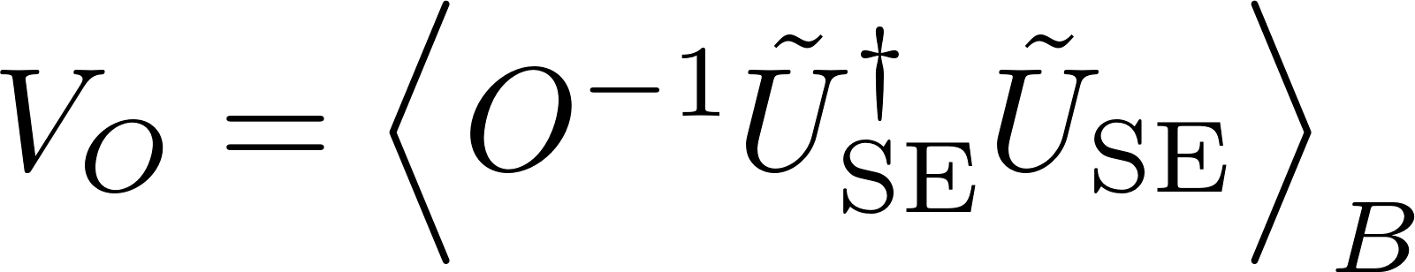
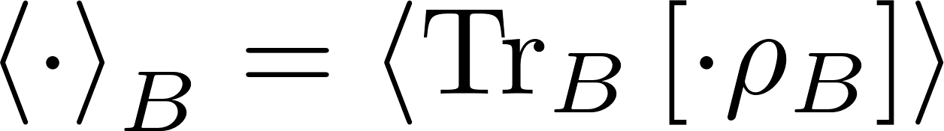

2. Noise Operator Formalism
Formalism introduced by Youssry et. al. (2020) separated closed-system dynamics and open-system dynamics using two different operators
In this formalism observable expectations for an initial state become:
where
with encoding qubit-environment interactions.

Slide 6
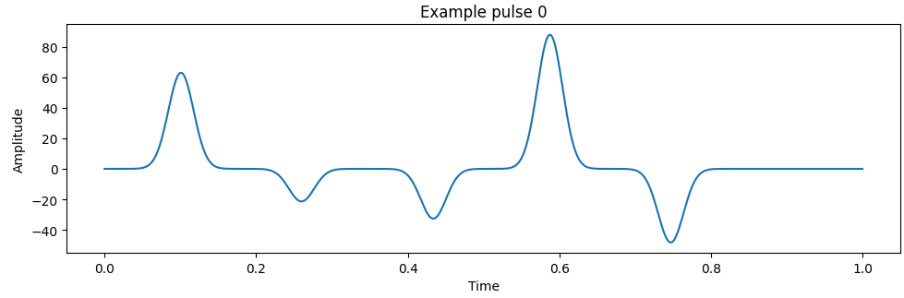
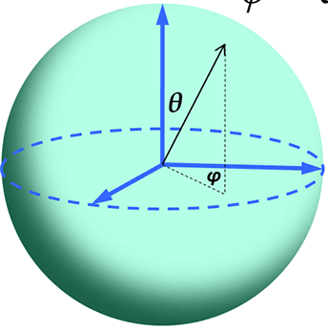
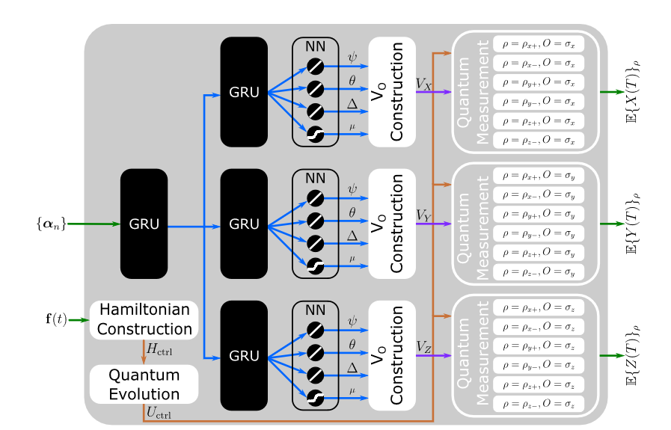
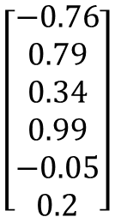
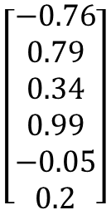
2. Noise Operator Formalism
$$\left[\begin{aligned}−0.76 \\ 0.79 \\ 0.34 \\ 0.99 \\ −0.05 \\ 0.2\end{aligned}\right]$$
$$\left[\begin{aligned}−0.76 \\ 0.79 \\ 0.34 \\ 0.99 \\ −0.05 \\ 0.2\end{aligned}\right]$$
Notes:
Explain difference between n and k

Slide 7
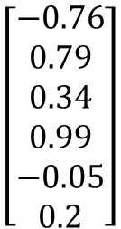
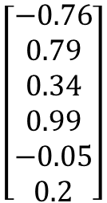
2. Noise Operator Formalism
$$\left[\begin{aligned}−0.76 \\ 0.79 \\ 0.34 \\ 0.99 \\ −0.05 \\ 0.2\end{aligned}\right]$$
$$\left[\begin{aligned}−0.76 \\ 0.79 \\ 0.34 \\ 0.99 \\ −0.05 \\ 0.2\end{aligned}\right]$$
Notes:
Explain difference between n and k

Slide 8
3. Environment Identification - Deriving Noise Operator
Notes:
Explain difference between n and k

Slide 9
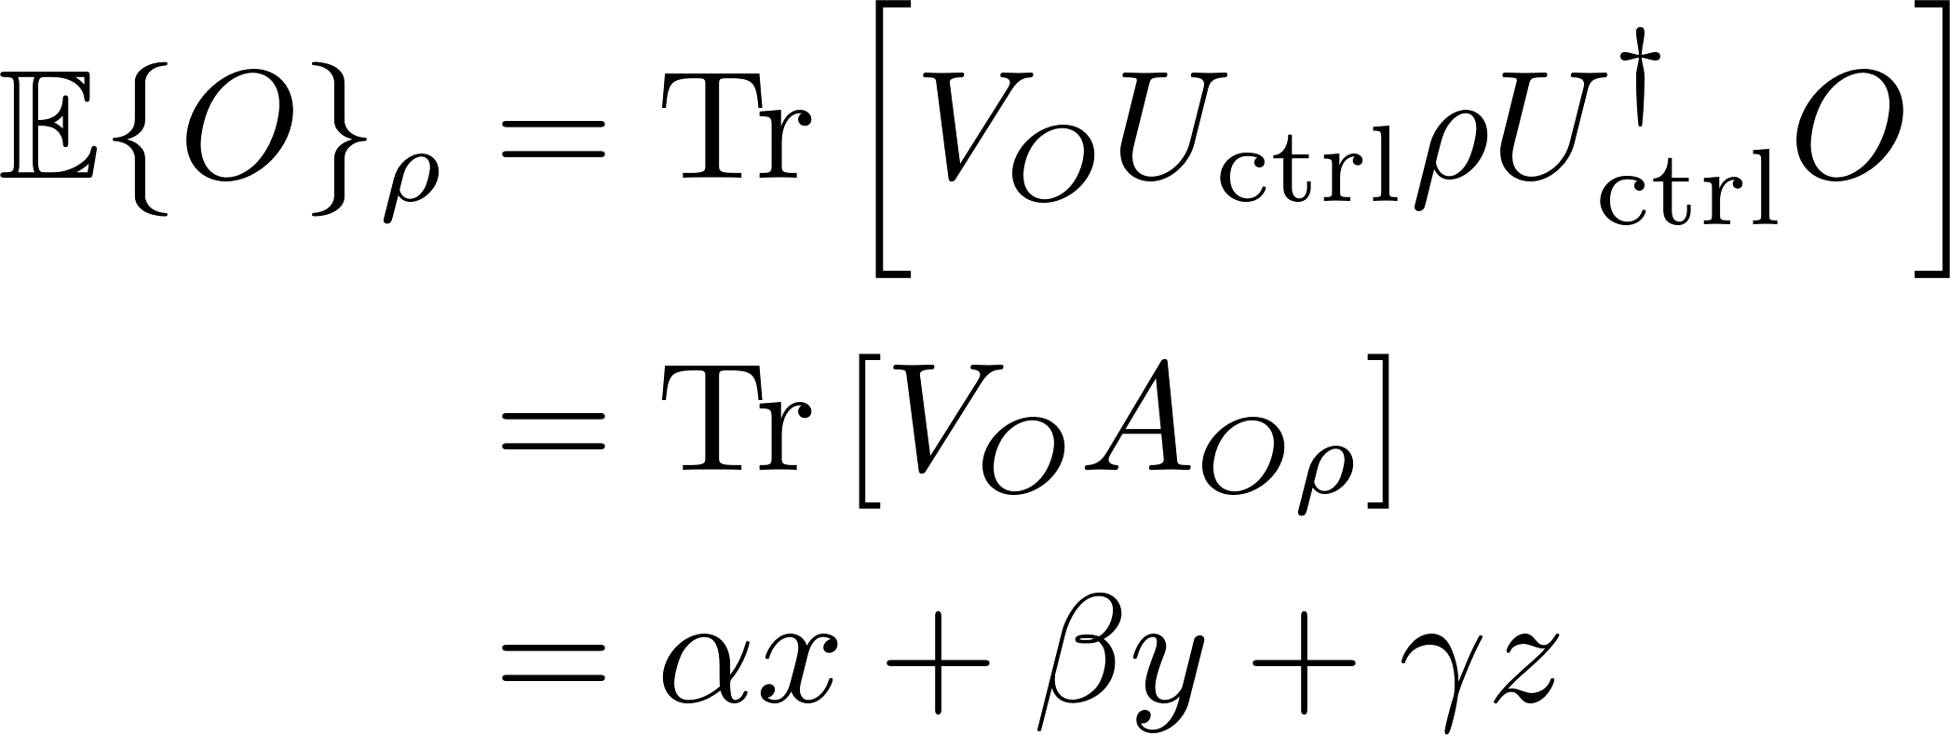
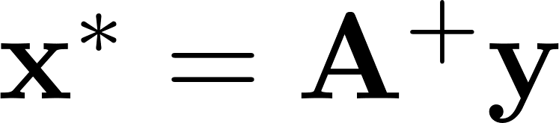
3. Environment Identification - Deriving Noise Operator
We start with
For a given observable, we have 6 expectations, so we solve the over-determined linear system
1000 estimated noise operators were calculated from expectations
Maximum error = 0.00002
Average error = 0.000003.
With GPU acceleration, 0.005 +/- 0.0001 seconds was required.
Notes:
Explain difference between n and k

Slide 10
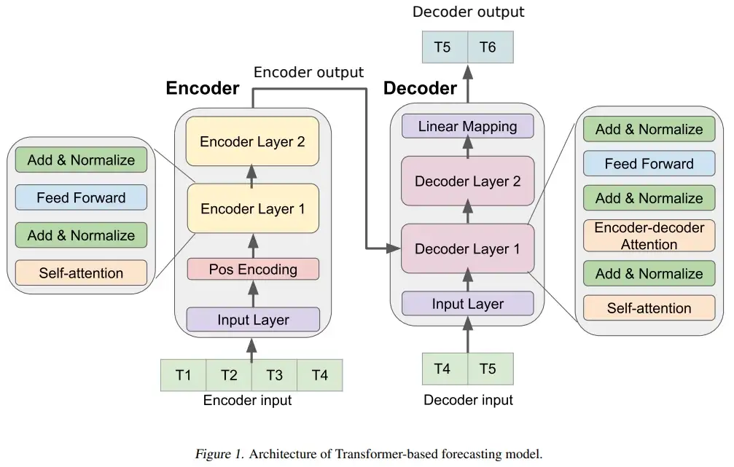
3. Environment Identification – Prediction of Noise Operator
FNN
FNN
Notes:
Explain difference between n and k

Slide 11
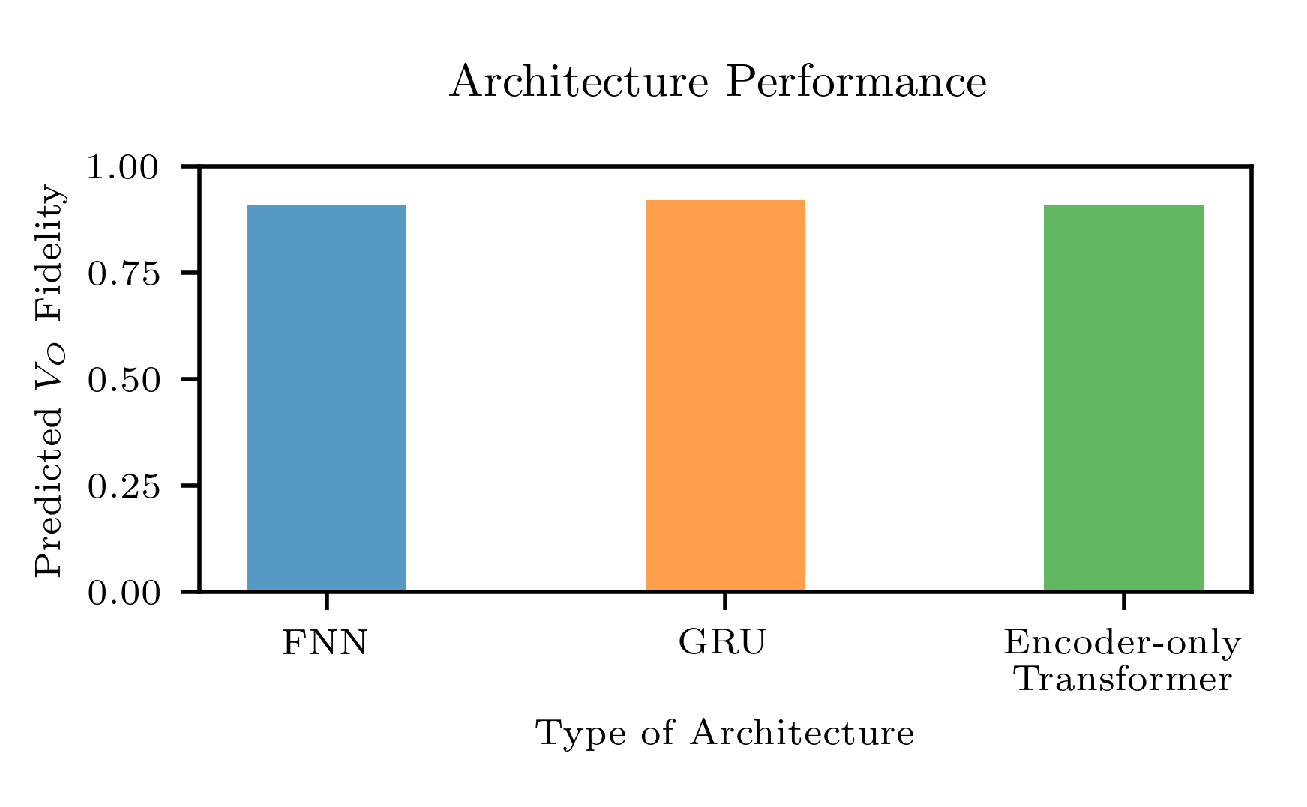
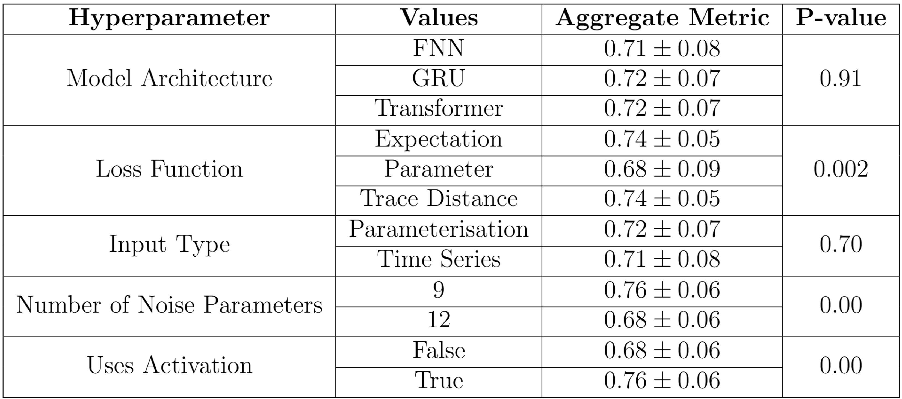
3. Environment Identification – Prediction of Noise Operator
Notes:
Explain difference between n and k

Slide 12
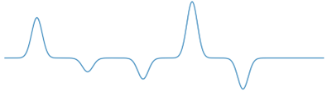
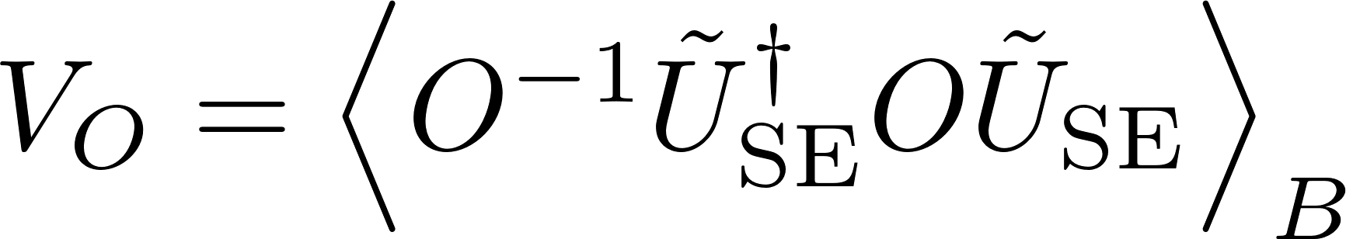
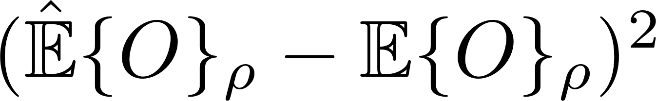

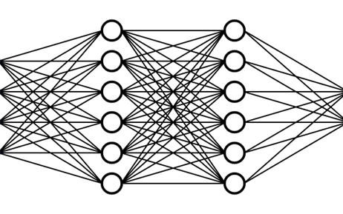

3. Environment Identification – Transformer-based Qubit Simulator
Simulated 1000 random control pulses
Non-stationary Gaussian coloured noise along x-axis and z-axis
Trained for 200 epochs with 80/20 training and test split
Achieve 96% accuracy
Notes:
Explain difference between n and k

Slide 13
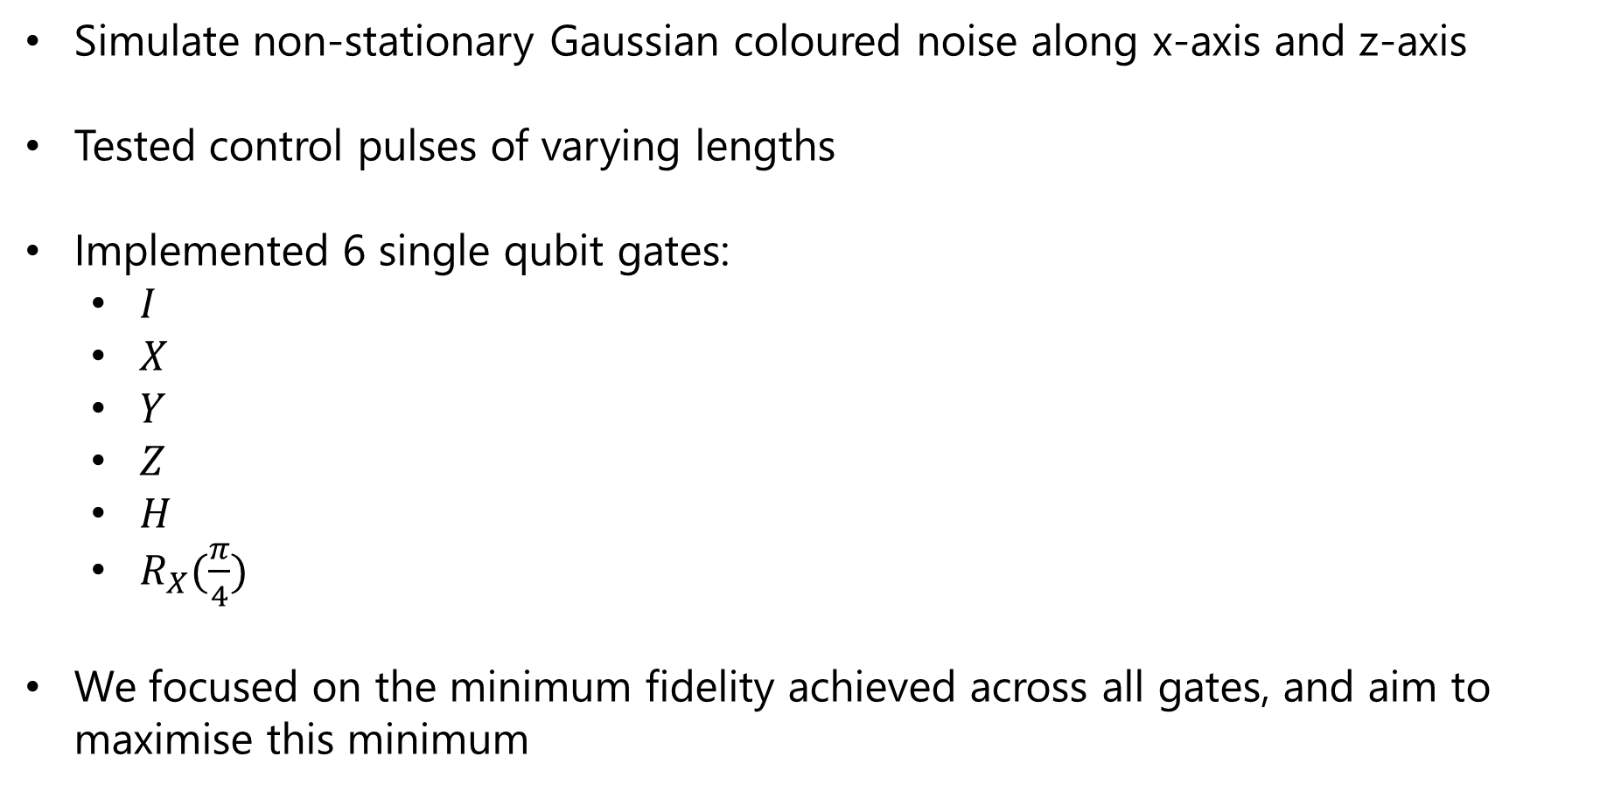
4. Qubit Control – Methodology
Simulate non-stationary Gaussian coloured noise along x-axis and z-axis
Tested control pulses of varying lengths
Implemented 6 single qubit gates:
$I$
$X$
$Y$
$Z$
$H$
$R_{X}(\frac{π}{4})$
We focused on the minimum fidelity achieved across all gates, and aim to maximise this minimum
Notes:
Explain difference between n and k

Slide 14


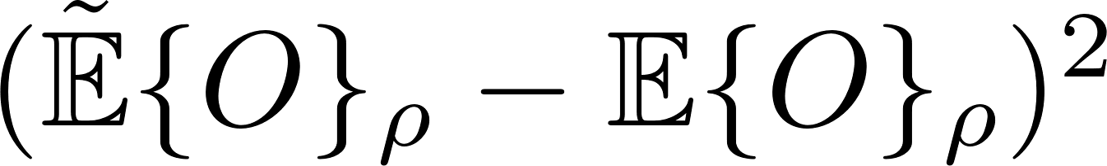
4. Qubit Control – Methodology
We optimise control pulses for a closed system using gradient-based methods using
In the open system we benchmarked:
100 random control pulses
Control pulses only optimised in noiseless case
Use evolutionary algorithm to ‘fine-tune’ preoptimised control pulses to open system
25 generations
Population of 40
Notes:
Explain difference between n and k

Slide 15
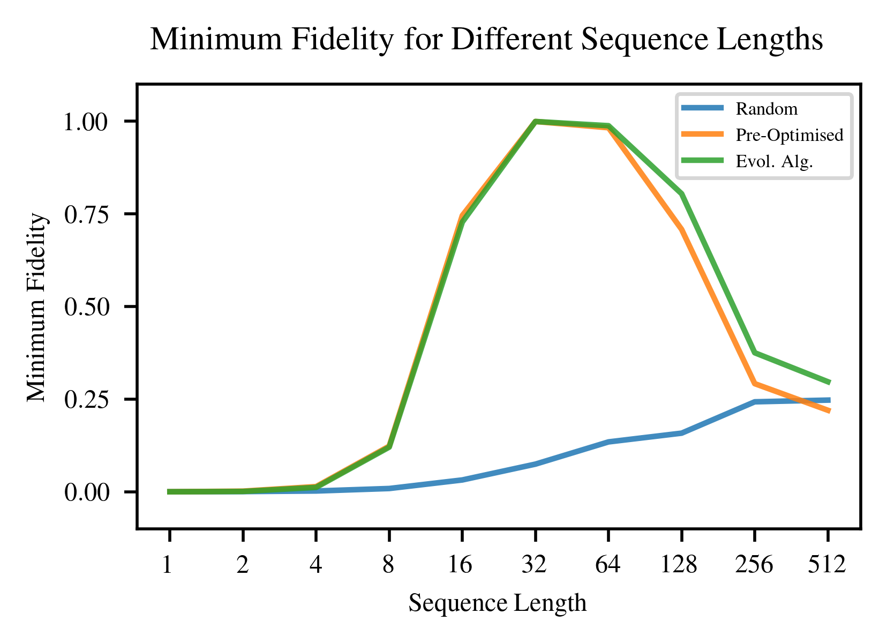
4. Qubit Control – Results
Notes:
Explain difference between n and k

Slide 16
5. Contributions & Future work
Contributions
Developed method to deduce noise operators
Benchmarked deep learning architectures and hyperparameters
Implemented a transformer-based qubit simulator that learns quantum noise
Optimised control pulses using gradient methods and evolutionary algorithms
Future work
Extended methodologies to two qubit systems
Use transformer-based qubit simulator to perform gradient-based optimisation of control pulses
Investigate non-Gaussian noise profiles (random telegraph noise)
Notes:
Explain difference between n and k

Slide 17
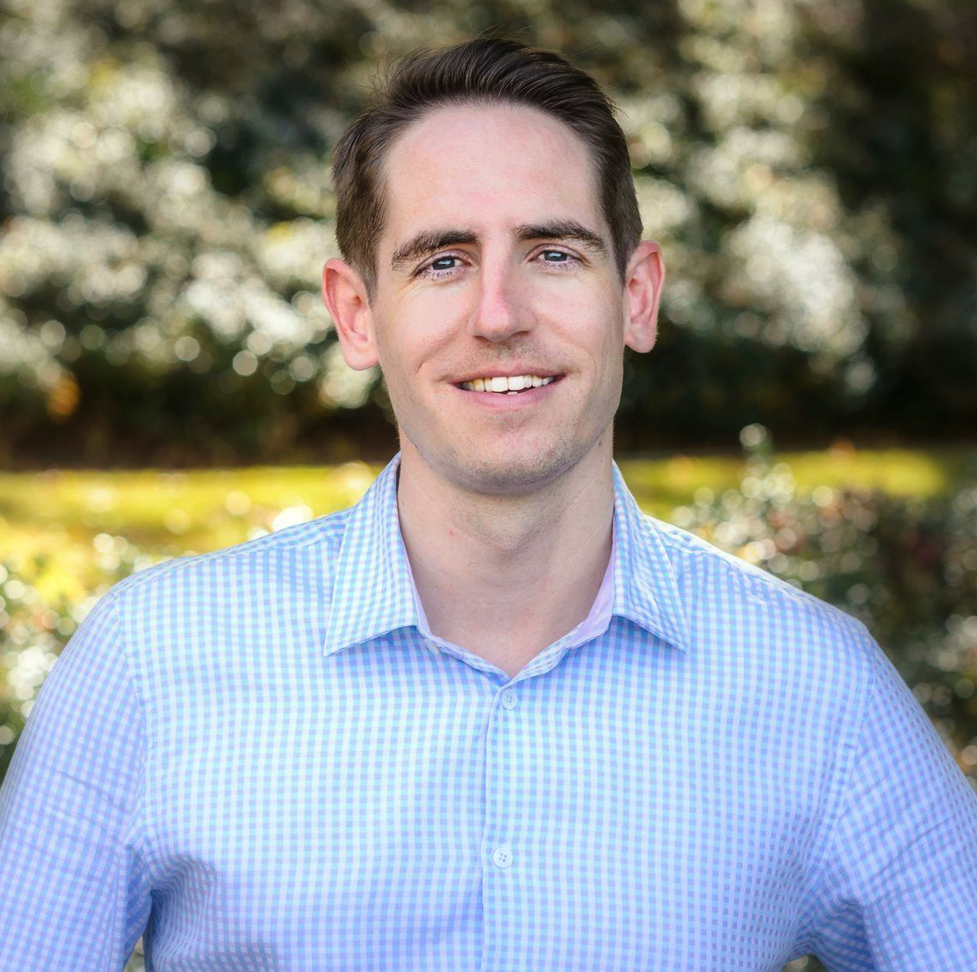




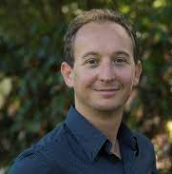

6. Acknowledgements
Matt Woolley
Slides
chris@cawise.net
Akram Youssry
Alberto Peruzzo
Notes:
Explain difference between n and k

Slide 18
References
[1] S. Li, X. Jin, Y. Xuan, et al., “Enhancing the locality and breaking the memory bottleneck of transformer on time series forecasting,” Advances in neural information processing systems, vol. 32, 2019.
[2] G. Zerveas, S. Jayaraman, D. Patel, A. Bhamidipaty, and C. Eickhoff, “A transformer-based framework for multivariate time series representation learning,” in Proceedings of the 27th ACM SIGKDD Conference on Knowledge Discovery & Data Mining, 2021, pp. 2114–2124.
[3] J. Devlin, M.-W. Chang, K. Lee, and K. Toutanova, “Bert: Pre-training of deep bidirectional transformers for language understanding,” arXiv preprint arXiv:1810.04805, 2018.
[4] J. Plested, X. Shen, and T. Gedeon, “Non-binary deep transfer learning for image classification,” arXiv preprintarXiv:2107.08585, 2021.
[5] A. Vezvaee, N. Shitara, S. Sun, and A. Montoya-Castillo, “Noise spectroscopy without dynamical decoupling pulses,” arXiv preprint arXiv:2210.00386, 2022.
[6] D. F. Wise, J. J. Morton, and S. Dhomkar, “Using deep learning to understand and mitigate the qubit noise environment,” PRX Quantum, vol. 2, no. 1, p. 010 316, 2021.
[7] A. Youssry, G. A. Paz-Silva, and C. Ferrie, “Characterization and control of open quantum systems beyond quantum noise spectroscopy,” npj Quantum Information, vol. 6, no. 1, p. 95, 2020.
[8] A. Youssry and H. I. Nurdin, “Multi-axis control of a qubit in the presence of unknown non-markovian quantum noise,” Quantum Science and Technology, vol. 8, no. 1, p. 015 018, 2022.[9] E. Perrier, A. Youssry, and C. Ferrie, “Qdataset, quantum datasets for machine learning,” Scientific Data, vol. 9, no. 1, p. 582, 2022.
[9] E. Perrier, A. Youssry, and C. Ferrie, “Qdataset, quantum datasets for machine learning,” Scientific Data,vol. 9, no. 1, p. 582, 2022.
Notes:
Explain difference between n and k

Slide 19
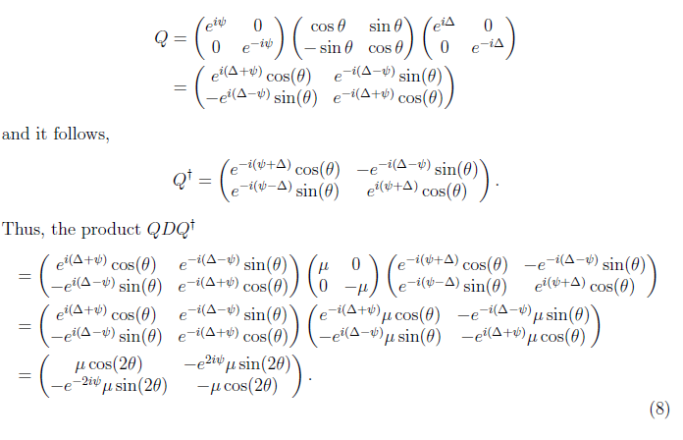
Extra – Calculating QDQ
Notes:
Explain difference between n and k

Slide 20
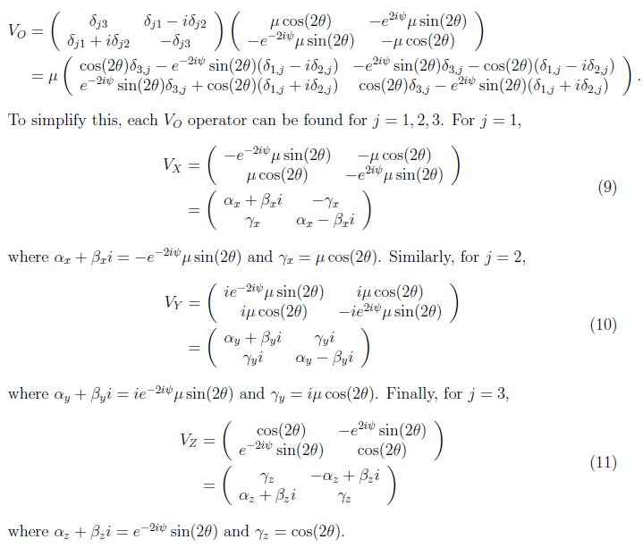
Extra – Calculating Vo
Notes:
Explain difference between n and k

Slide 21
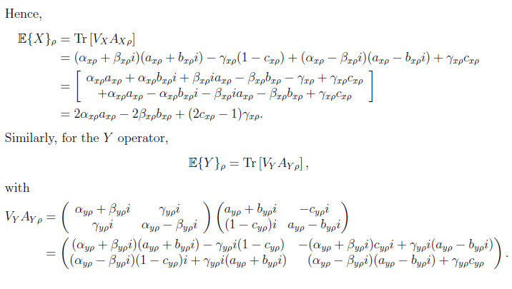
Extra – Calculating Vo Matrix
Notes:
Explain difference between n and k

Slide 22
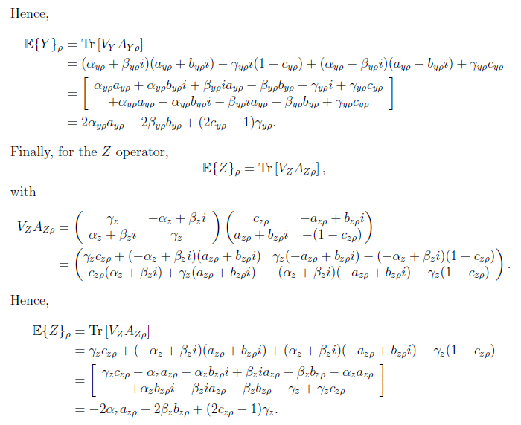
Extra – Calculating Vo Matrix
Notes:
Explain difference between n and k

Slide 23
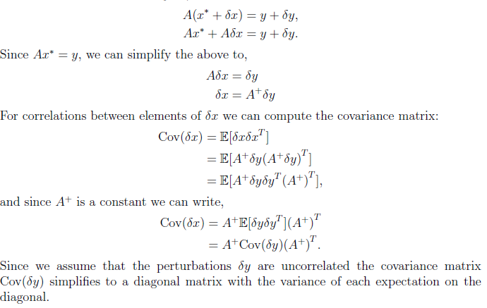
Extra – Calculating Covariance
Notes:
Explain difference between n and k

Slide 24
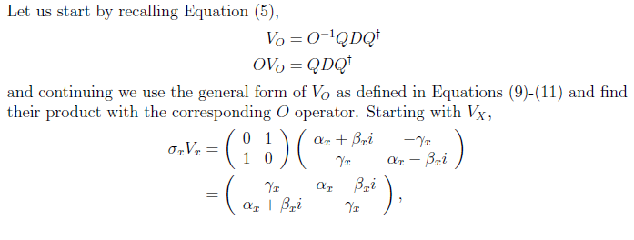
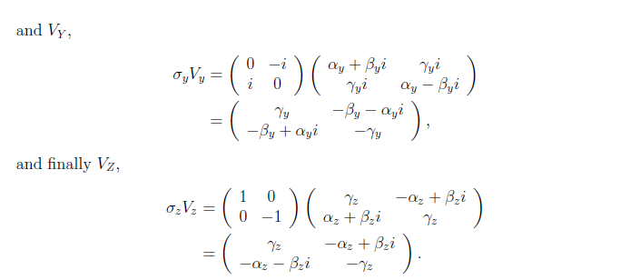
Extra – Calculating Parameters
Notes:
Explain difference between n and k

Slide 25
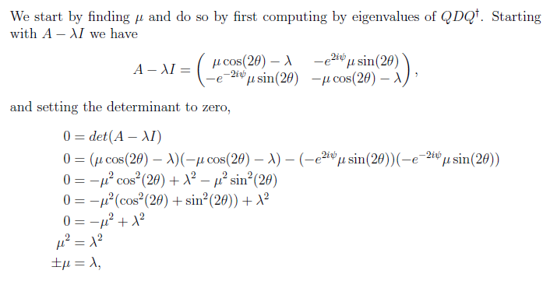
Extra – Calculating Eigenvalues
Notes:
Explain difference between n and k

Slide 26
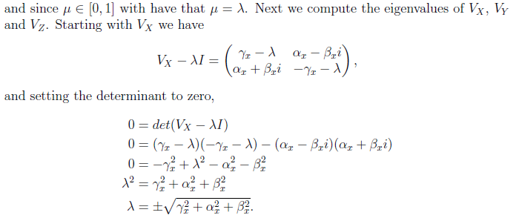
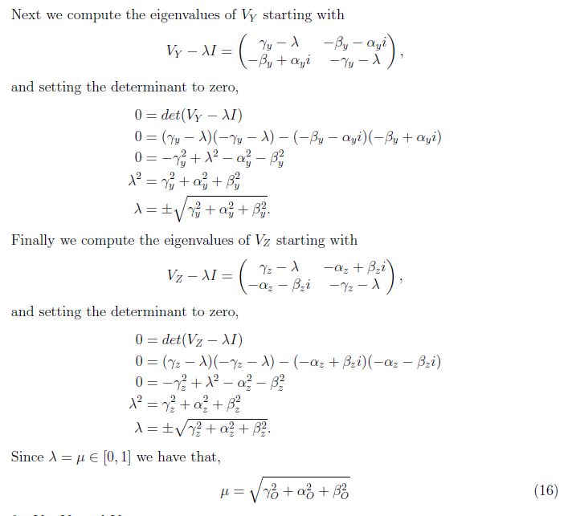
Extra – Calculating Eigenvalues
Notes:
Explain difference between n and k

Slide 27
Extra – Calculating Eigenvalues
Notes:
Explain difference between n and k

Slide 28
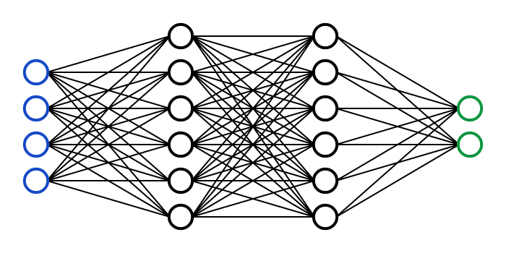
Extra – Encoder Only Architecture
Notes:
Explain difference between n and k

